Slide 1
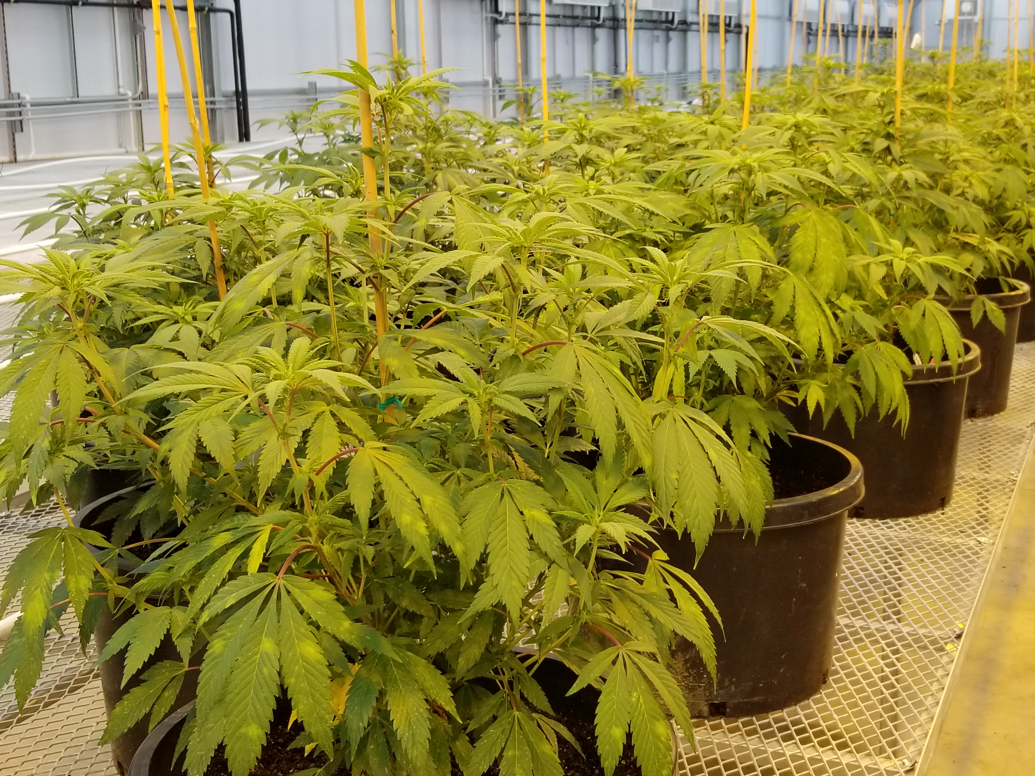

Profiles of Disease Resistance Genes in the Cannabis Pangenome Kelly Vining Brian Knaus Department of Horticulture Oregon State University

Slide 2

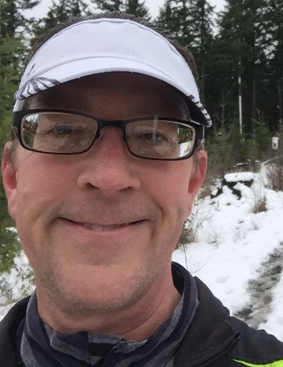
Cannabis pangenome overview
Brian Knaus
193 genomes from 141 samples:
European hemp Asian hemp North American feral Elite marijuana Modern high cannabinoid hemp
39 fully haplotype-resolved chromosome level assemblies (78 haps)
Cannabis pangenome reference based on a Type I (MJ, THC-producer) crossed to a Type III (hemp, CBD-producer)

Slide 3
Plant disease resistance “R” gene functions
Gene-for-gene resistance: pathogen-secreted effector recognized by compatible host R gene
Loss-of-function mutation of host S gene (MLO/mlo)

Slide 4
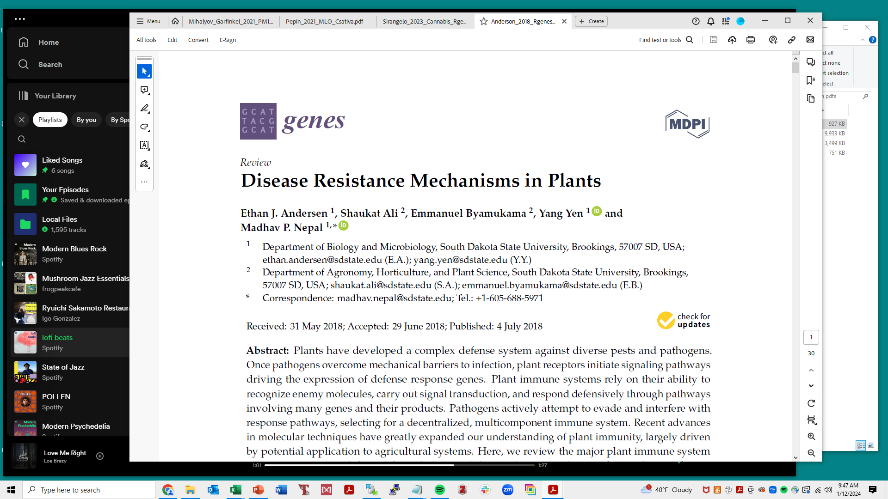
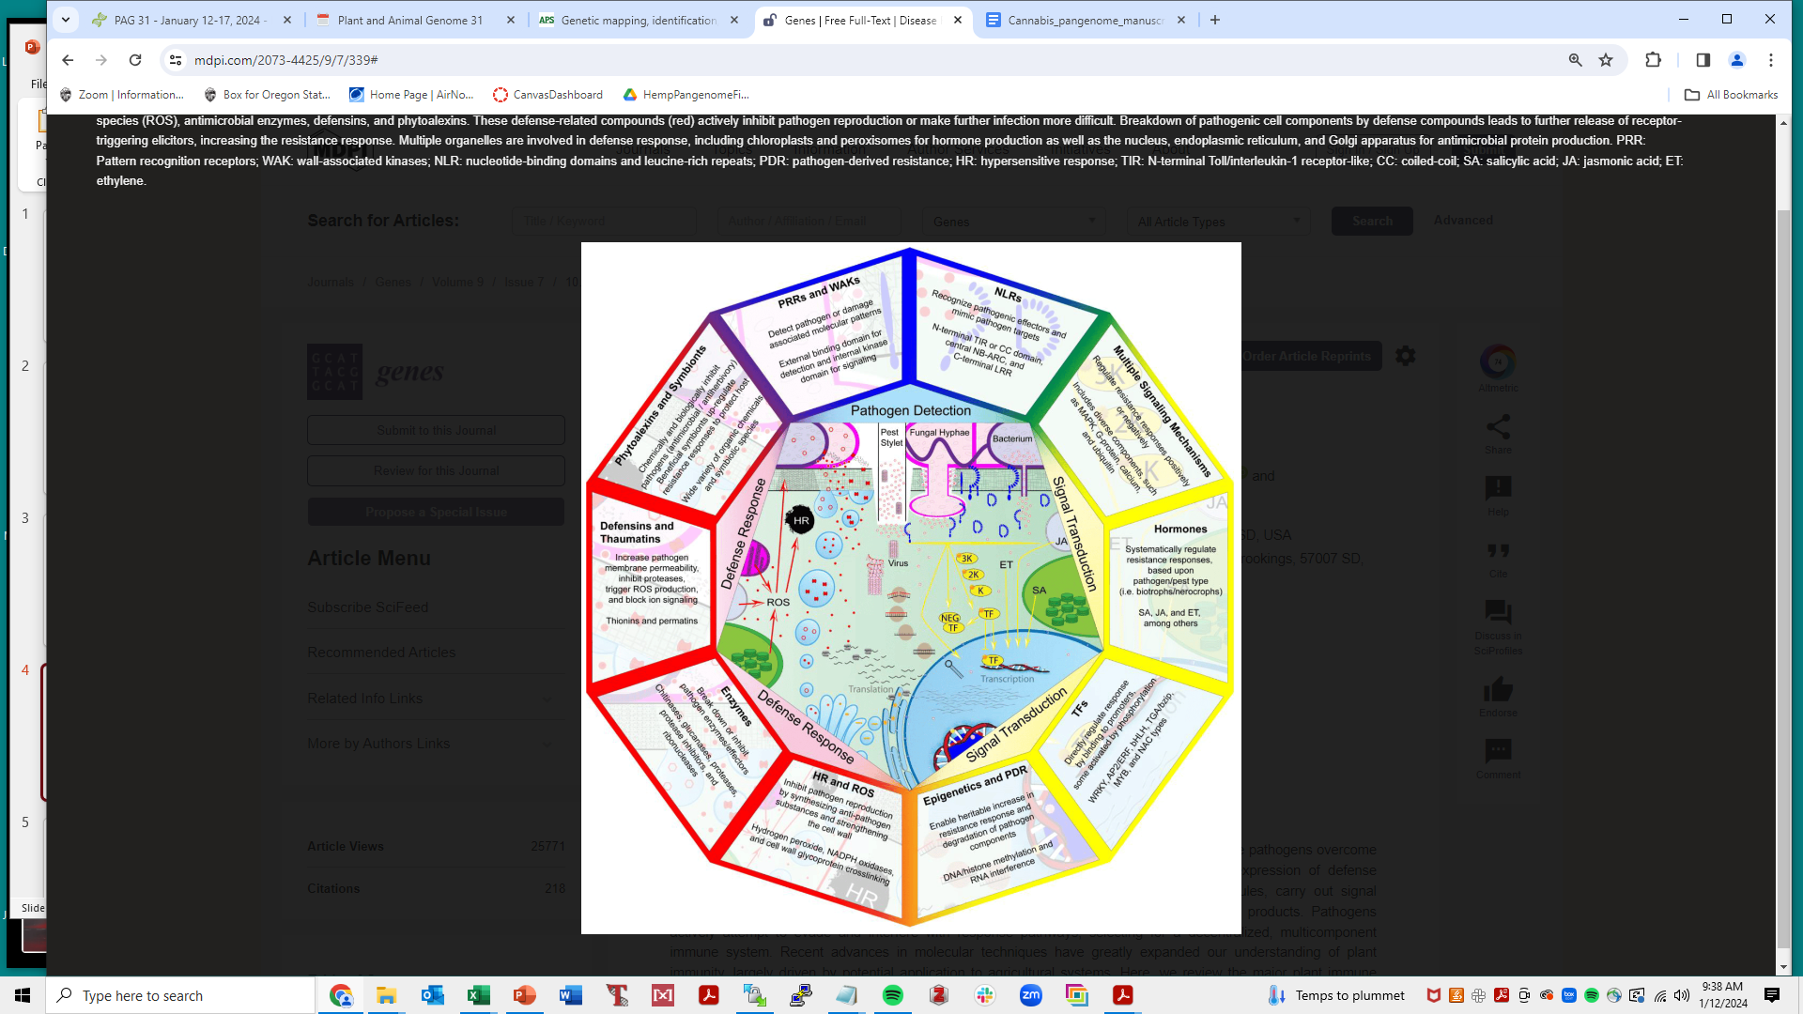
Notes:
Signal transduction = gene regulation

Slide 5
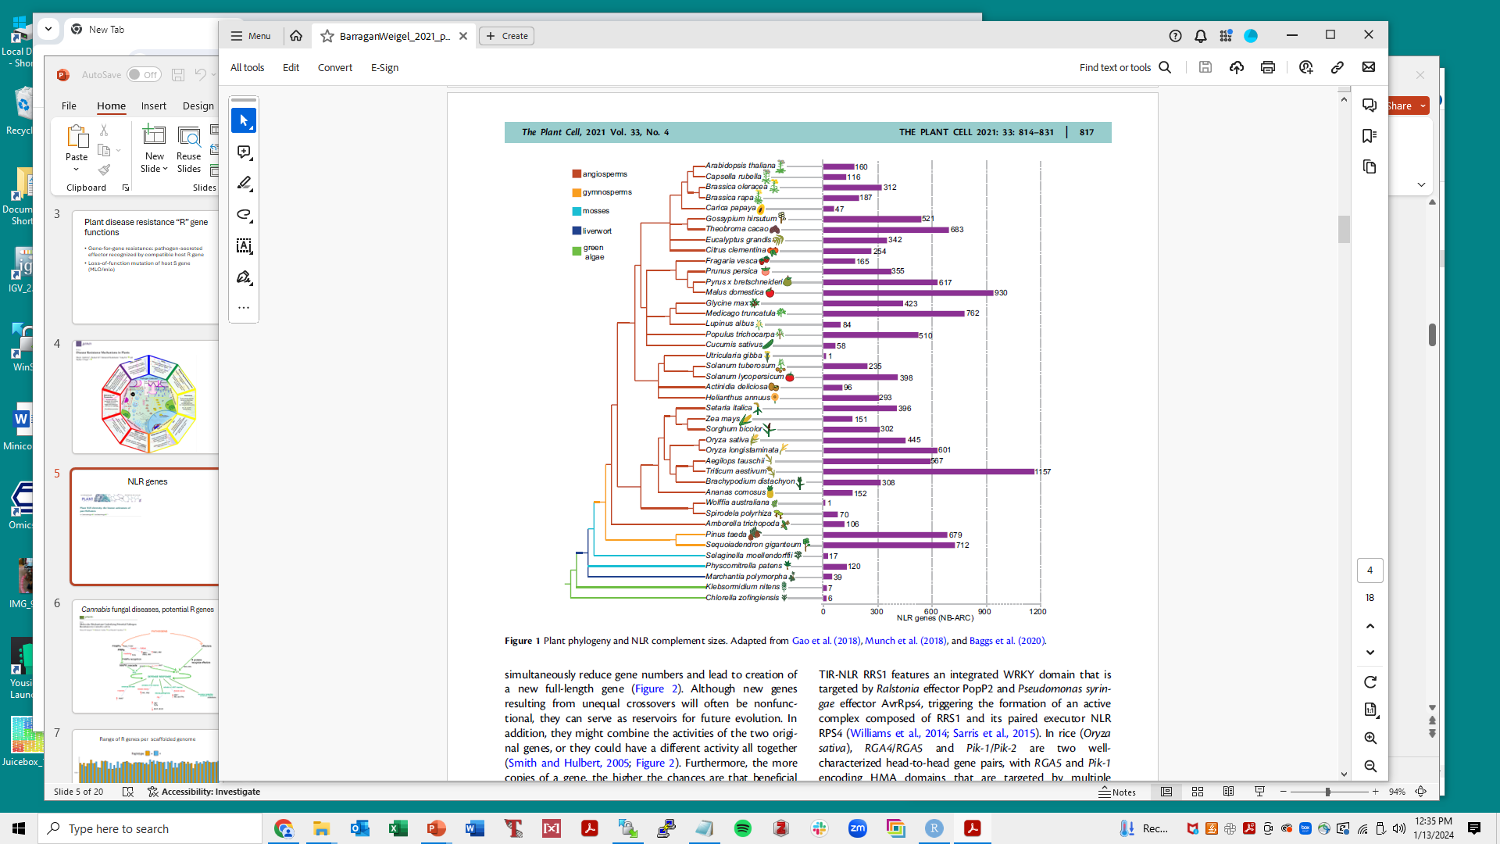
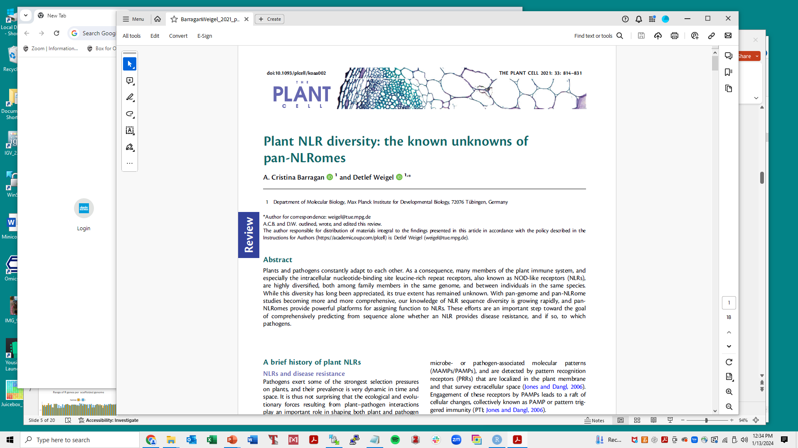
Nucleotide Binding Site-Leucine-Rich Repeat (NLR) genes

Slide 6
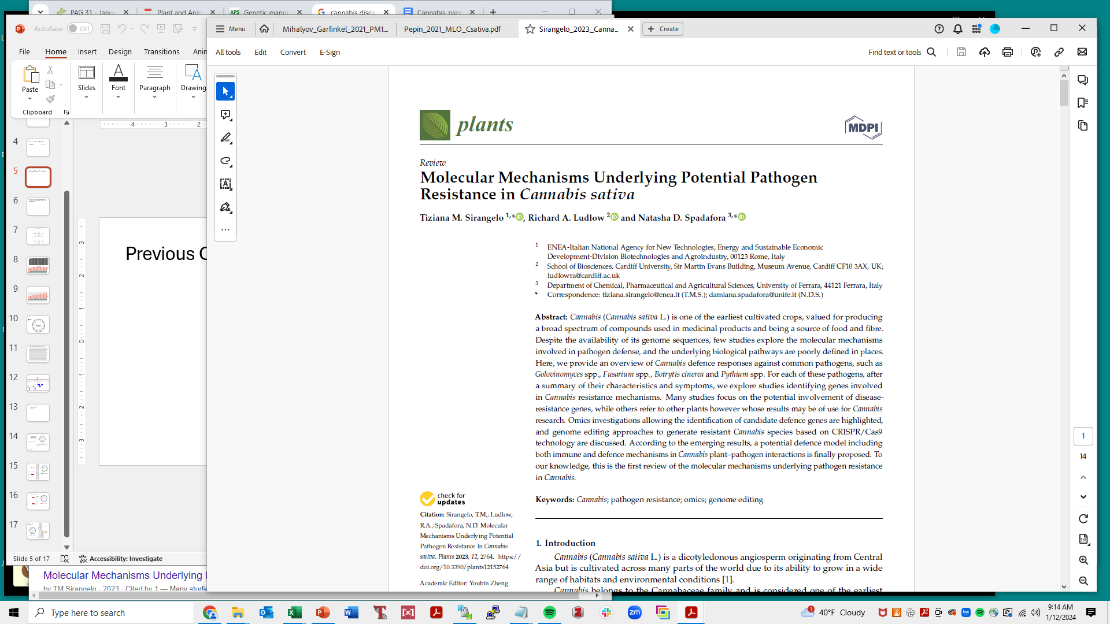
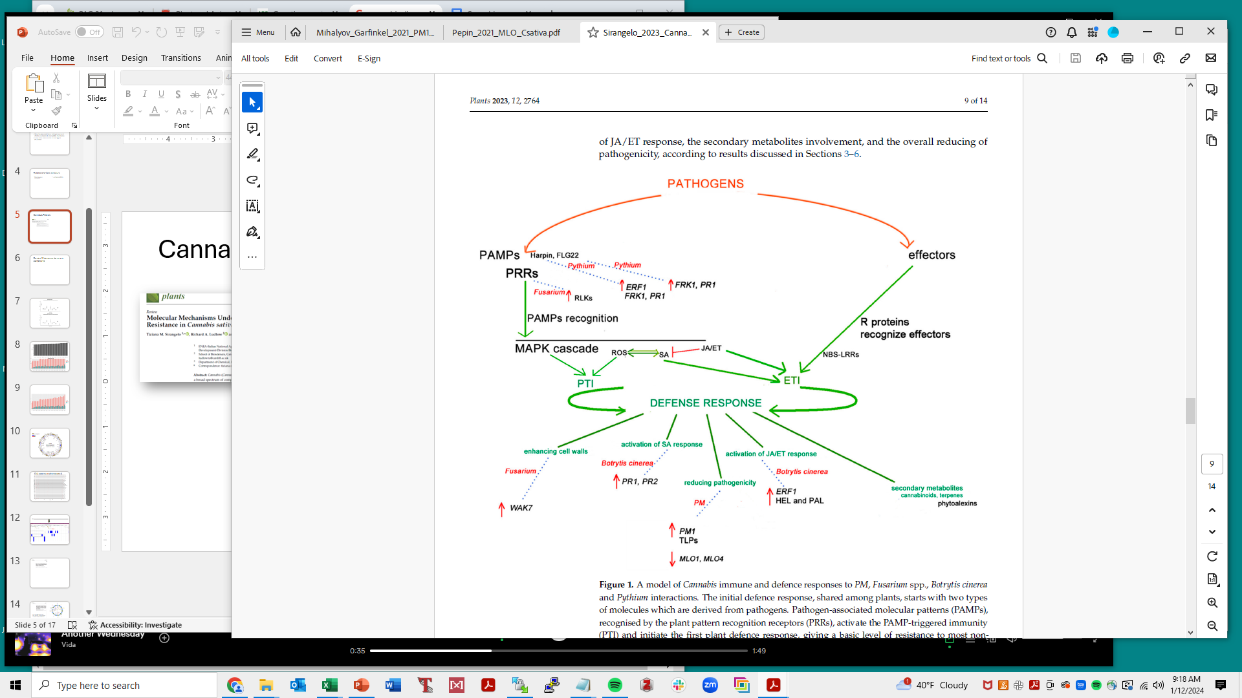
Cannabis fungal diseases, potential R genes
Notes:
Figure 1. A model of Cannabis immune and defence responses to PM, Fusarium spp., Botrytis cinerea. and Pythium interactions.

Slide 7
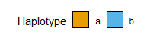
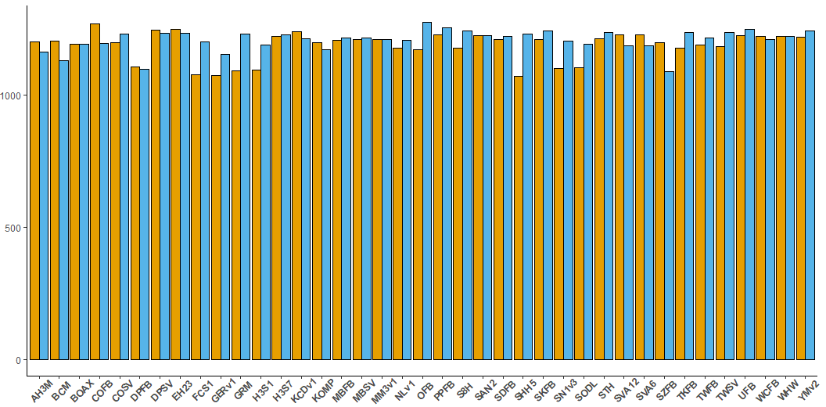
Range of R genes per scaffolded genome

Slide 8
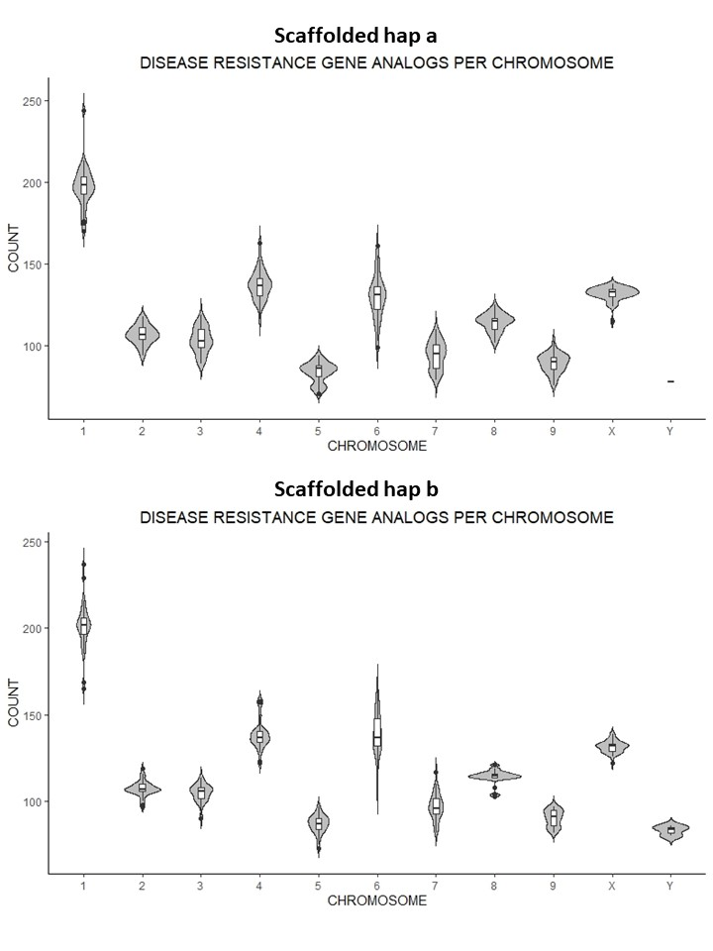
Haplotype a
Range of R genes per chromosome
Haplotype b

Slide 9
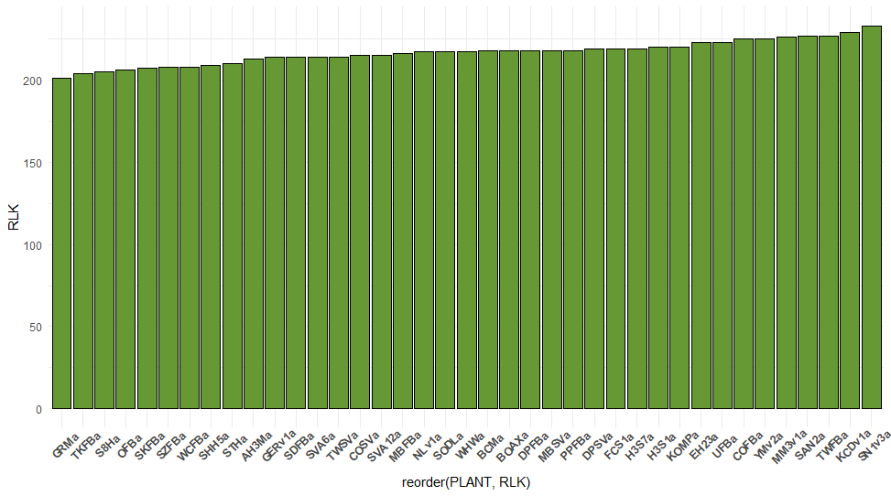
CNL, TNL gene counts per scaffolded genome
Largest R gene category:
Receptor-Like Kinases (RLKs)
Notes:
39 scaffolded hap_a genomes

Slide 10
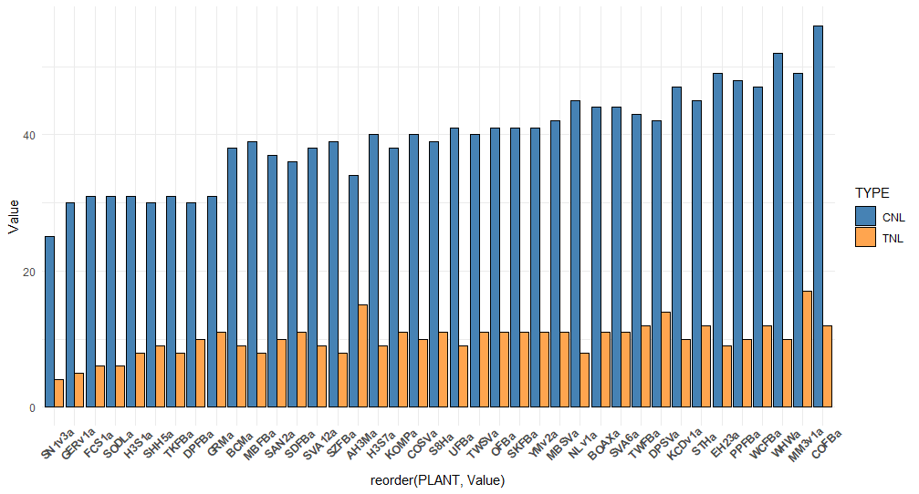
CNL, TNL genes

Slide 11
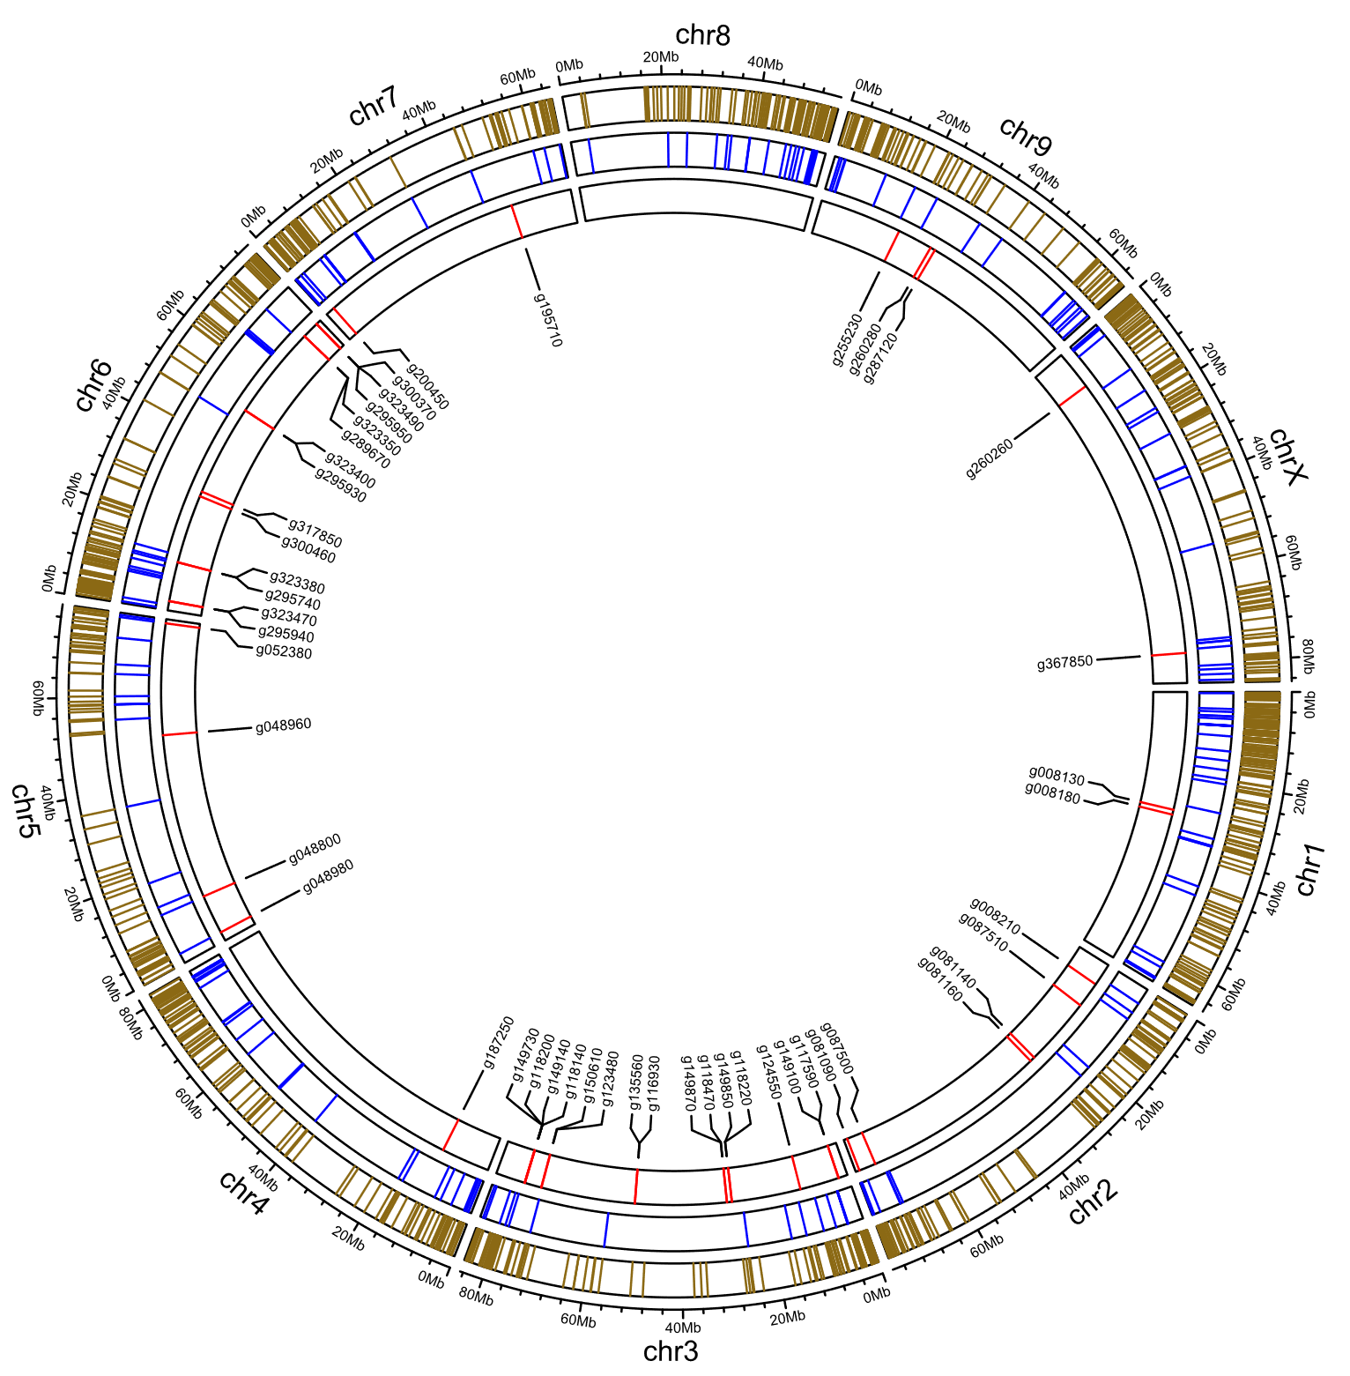
All categories
R genes most dense at 0-20 Mb on chr1
Most CNLs on chromosomes 3 and 6
RLK
CNL
EH23a
R gene subcategories:
Receptor-like kinases,
Coiled-coil NLR genes

Slide 12
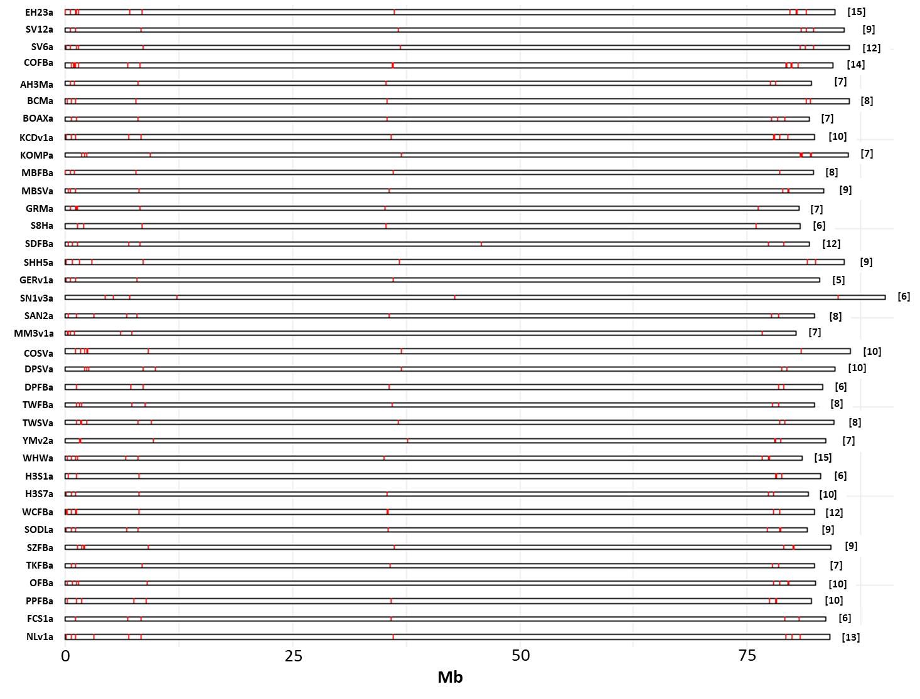
CNL patterns on chromosome 3

Slide 13
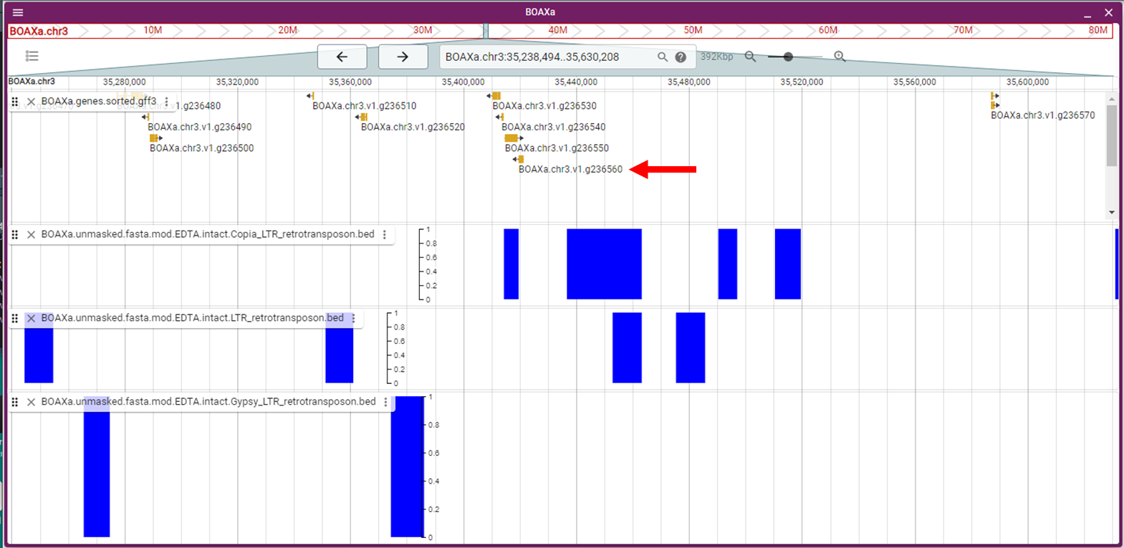

Slide 14
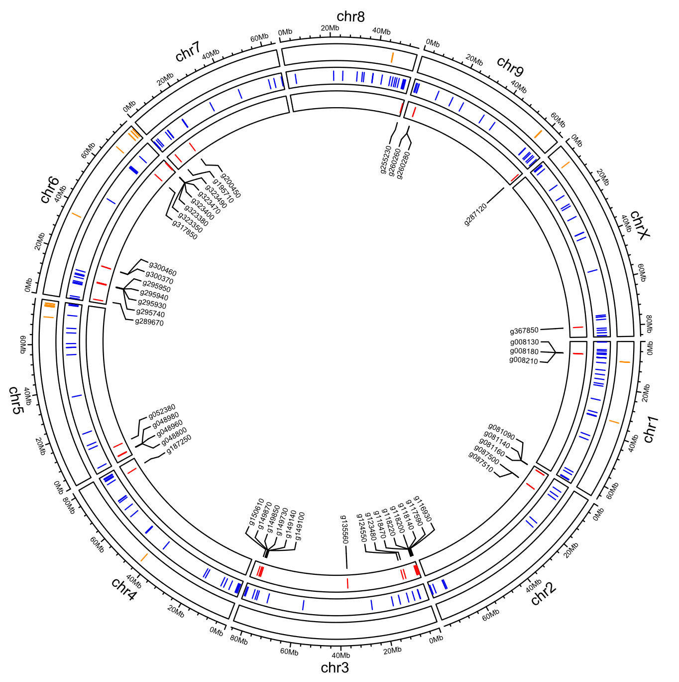
R genes and terpene synthases
EH23a
TPS
RLK
CNL

Slide 15
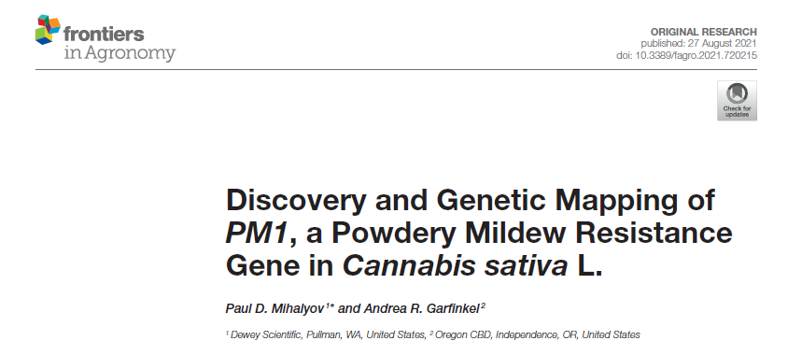
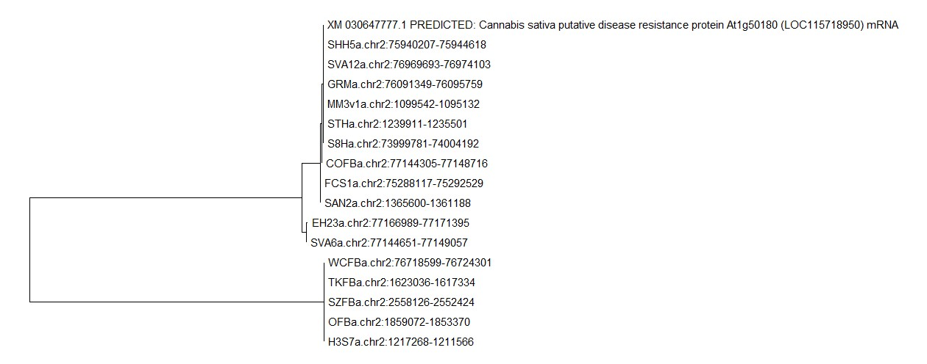
PM1 alleles
^G

Slide 16
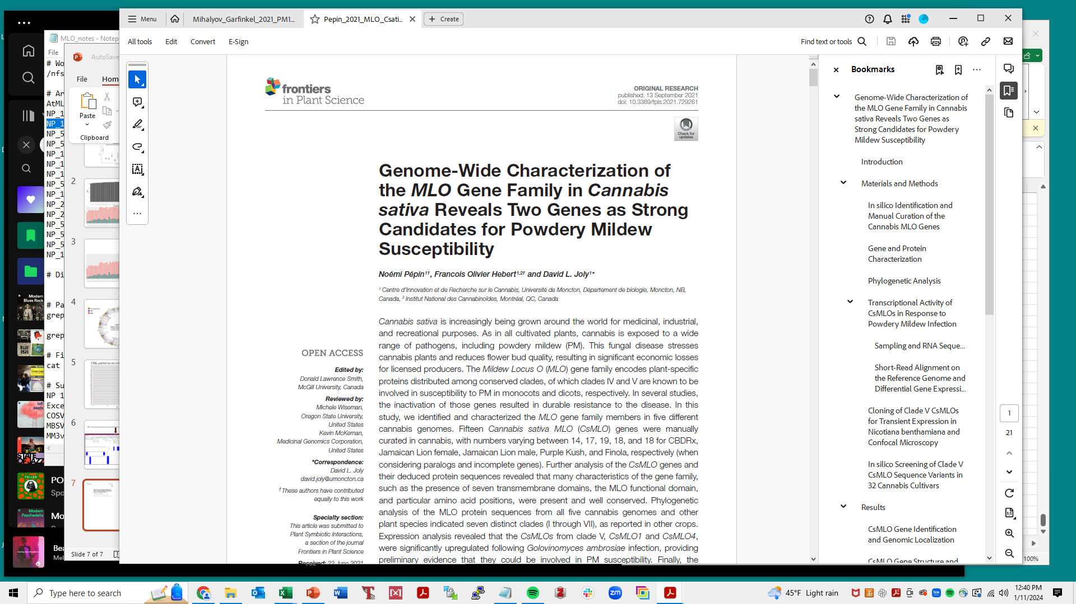
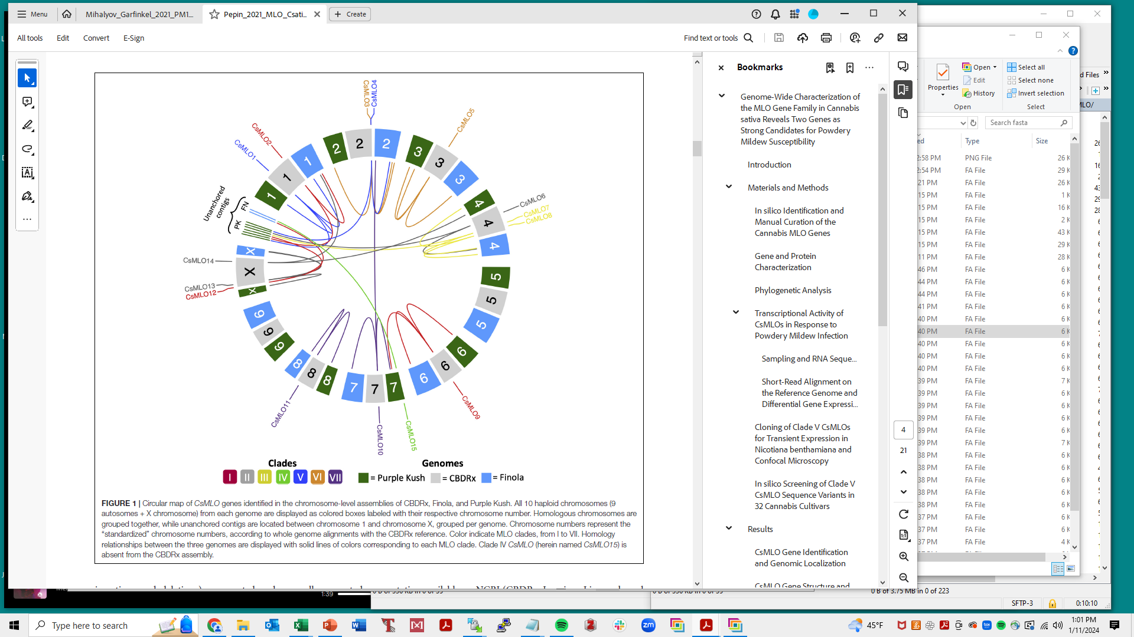
mlo- based resistance not race-specific, so has potential to confer durable resistance
Tblastx with same Arabidopsis 15-protein set
No hits on chr3,8,9

Slide 17
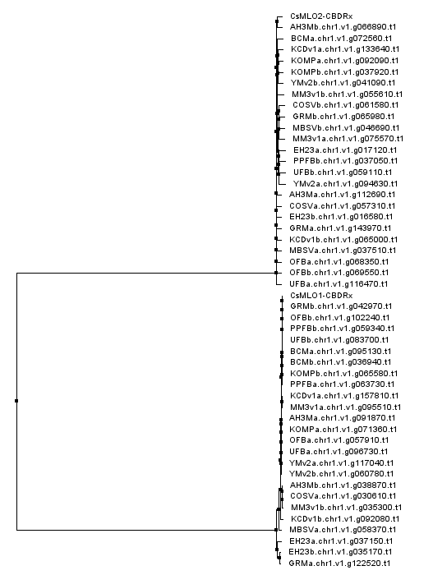
CLADE I
CLADE V

Slide 18
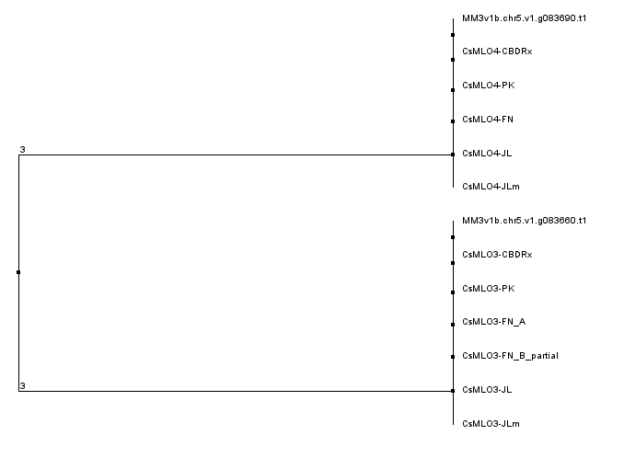
Mother Mary chr5 MLOs group with CsMLO3, CsMLO4
CLADE V
CLADE III

Slide 19
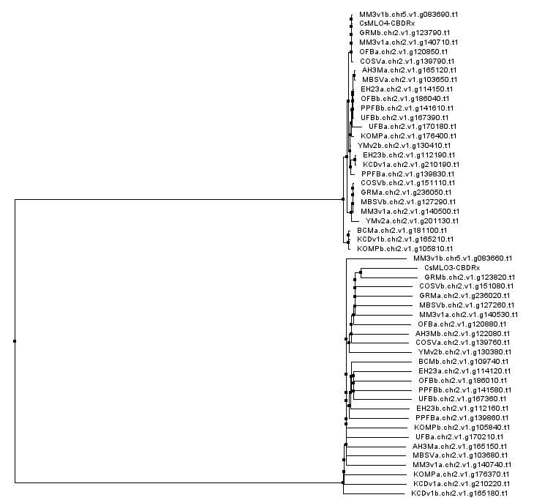
Mother Mary chr5 MLOs cluster with CSMLO3, CSMLO4
CLADE V
CLADE VI

Slide 20
Summary

Slide 21
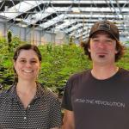
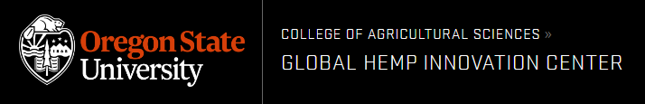
THANK YOU!
Michael Lab
Todd P. Michael
Ryan C. Lynch
Lillian K. Padgitt-Cobb
Nolan T. Hartwick
Nick Allsing
Anthony Alyward
Allen Mamerto
Justine Kitony
Kelly Colt
Oregon CBD
Seth Crawford
Eric Crawford
Andrea Garfinkel
Aaron Trippe

